Slide 1
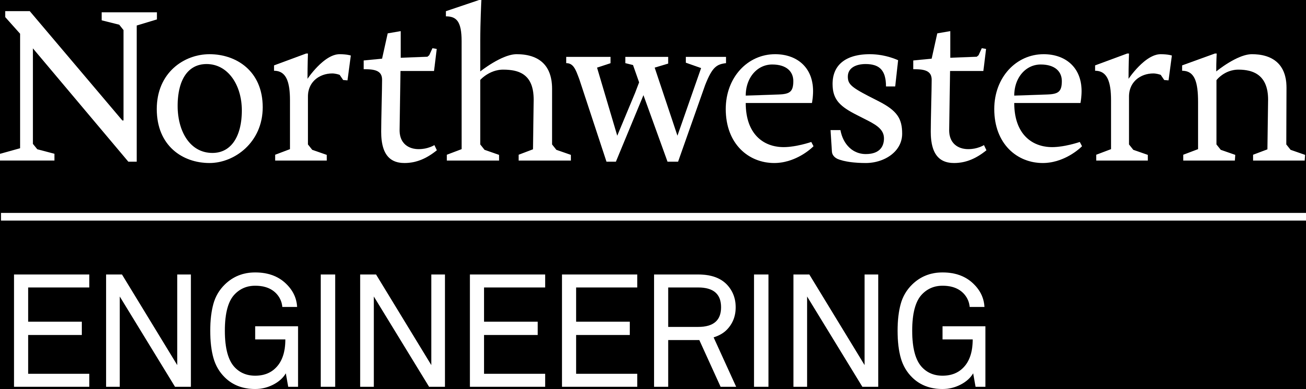
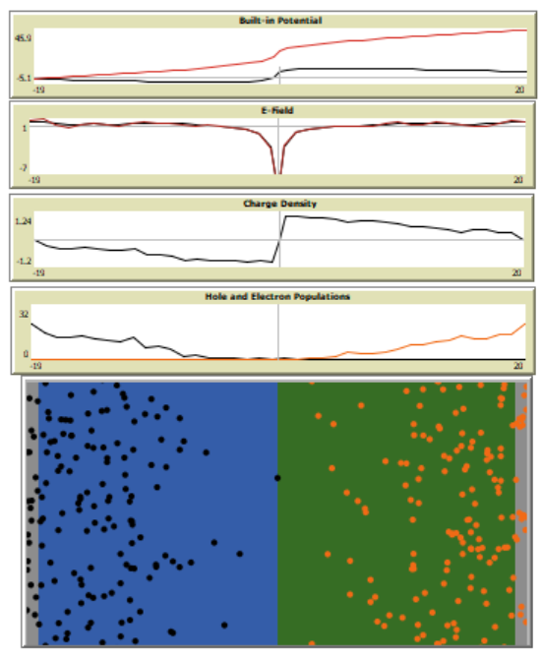
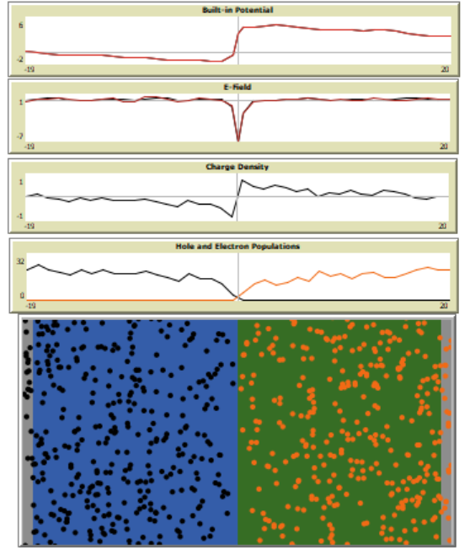
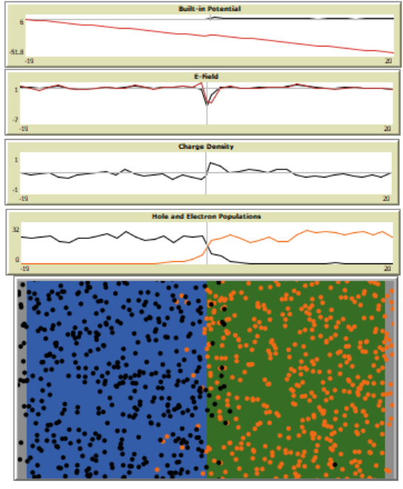
Learning Modules for Emergent Semiconductor Device Behavior using NetLogo Modeling of p-n Junctions
Module Outline:
Emergent Behavior
Electronic properties at the p-n junction.
Materials influence on junction properties
Deriving governing laws (Poisson, Gauss, Continuity)
Device Modeling
Simulated rectifying behavior vs ideal diode behavior
Analyzing NetLogo model limitations
Expansion of models:
Rectifying behavior
MOSFETs
LEDs/PV
(Left) Cartoon depication of charge carrier behaviors in a p-n junction under (a) unbiased (b) forward bias and (c) reverse bias.
(Top) Device characteristics of a p-n junction: current-voltage characteristics (top-left) and rectifying behavior (top-right)
Jonathan D. Emery¹ and Jacob Z. Kelter² ¹Northwestern University, Department of Materials Science Engineering
²Northwestern University, Computer Science and Learning Sciences
Reverse Bias
Equilibrium
Forward Bias
Computational Thinking in STEM Summer Institute

